Slide 1

BENZENE RING FORMATION ANIMATION.

Slide 2
HELLO!
Hello! We are…
Pranav Bhanot 20BAI1087
Prathamesh Potabatti 20BAI1076
Karan Dua 20BAI1012

Slide 3
Introduction.
01
We all have studied rigorous Chemistry at some points in our lives and the most gruelling of all was Organic Chemistry. So this animation is a token of respect for everyone’s efforts and perseverance that has brought them to this point in their lives.

Slide 4
DID YOU KNOW?
Benzene evaporates into the air very quickly and thus we created this infinitely forming and dissolving benzene ring to signify the real thing.

Slide 5
ANIMATION IS NOT THE ART OF DRAWINGS THAT MOVE BUT THE ART OF MOVEMENTS THAT ARE DRAWN.
― Norman McLaren

Slide 6
TOOLS USED!
This is where you section ends. Duplicate this set of slides as many times you need to go over all your sections.

Slide 7
Pugsjs
The general rendering process of Pug is simple. pug.compile() will compile the Pug source code into a JavaScript function that takes a data object (called “locals”) as an argument. Call that resultant function with your data, and voilà!, it will return a string of HTML rendered with your data.
The compiled function can be re-used, and called with different sets of data.

Slide 8
CSS
Cascading Style Sheets is a style sheet language used for describing the presentation of a document written in a markup language such as HTML or XML. CSS is a cornerstone technology of the World Wide Web, alongside HTML and JavaScript. Cascading Style Sheets (CSS) is a stylesheet language used to describe the presentation of a document written in HTML or XML (including XML dialects such as SVG, MathML or XHTML). CSS describes how elements should be rendered on screen, on paper, in speech, or on other media.

Slide 9
Let’s review some facts.
JAVASCRIPT
CSS
HTML
PUGS JS
CODEPEN
ANIMATIONS

Slide 10
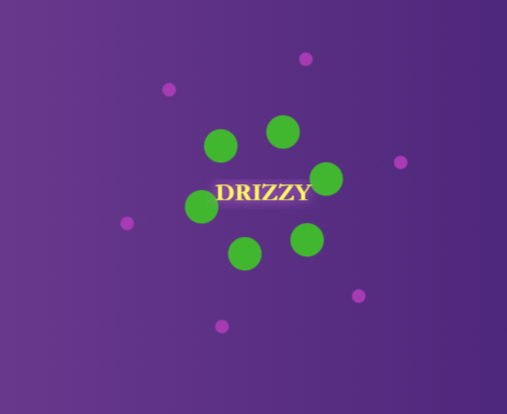
THE RING!
This is a screenshot of a phase of the animation.

Slide 11
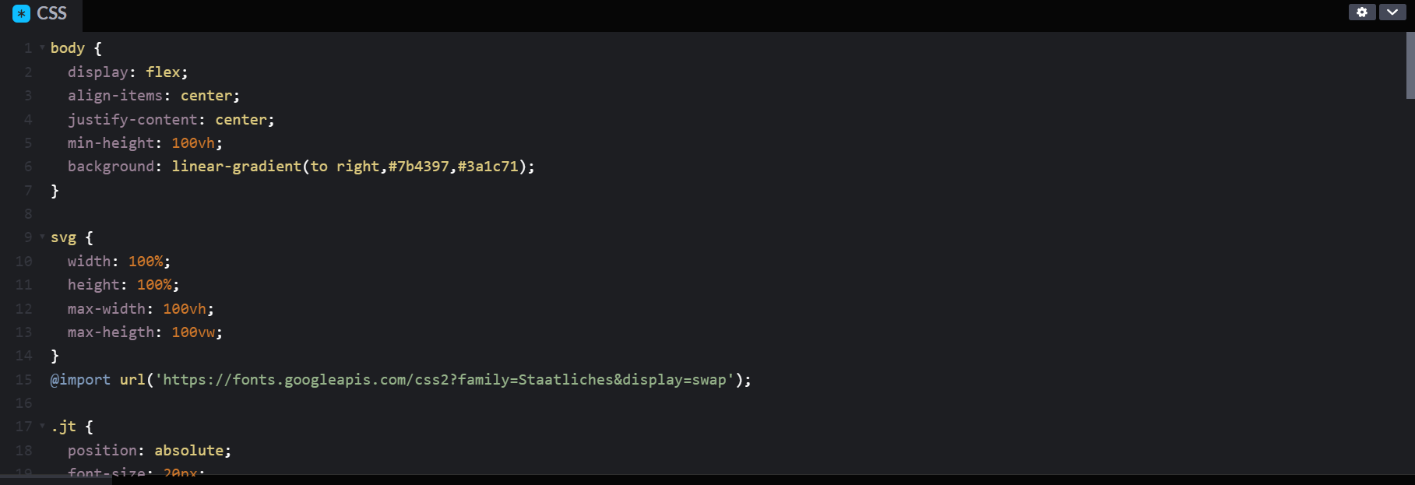
CODE SNIPPET CSS

Slide 12
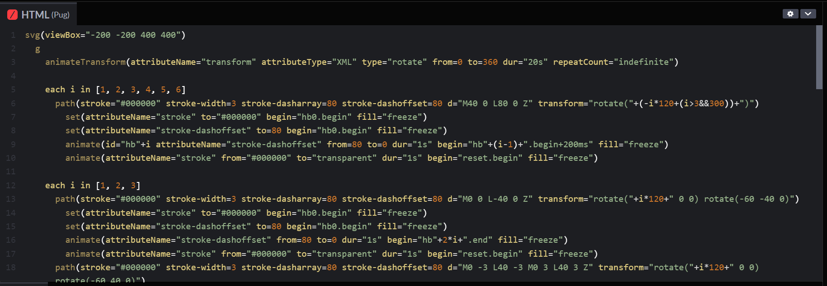
CODE SNIPPET HTML

Slide 13
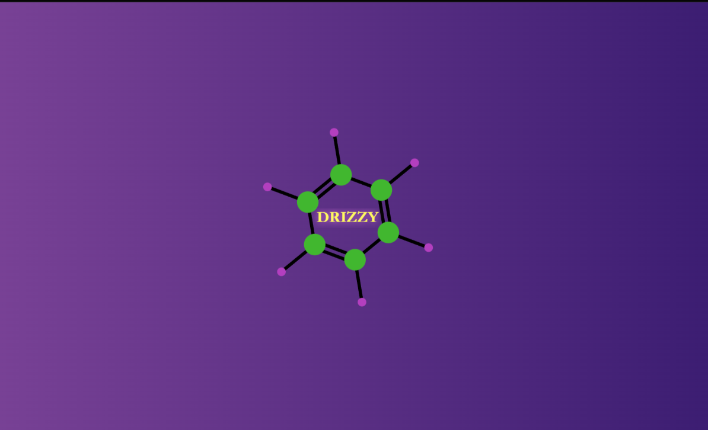
THE RING!
This is a screenshot of a phase of the animation.

Slide 14
THANK YOU.

